Slide 1


Slide 2
Common CSS Properties
Background
Fonts

Slide 3
Background
background: lightblue url("img_tree.gif") no-repeat fixed center;
background-color: red;
background-image: url("img_tree.gif");
background-repeat: no-repeat/repeat;
background-attachment: fixed;
background-blend-mode: normal|multiply|screen|overlay|darken|lighten|color-dodge|saturation|color|luminosity;
background-origin : border-box|padding-box|content-box|initial|inherit;
background-position: 50% 50%; or background-position: center top;
background-size: 75% 50%:

Slide 4
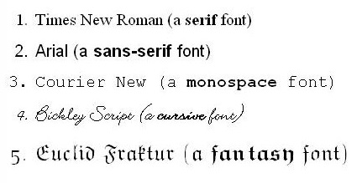
FONTS

